Slide 1
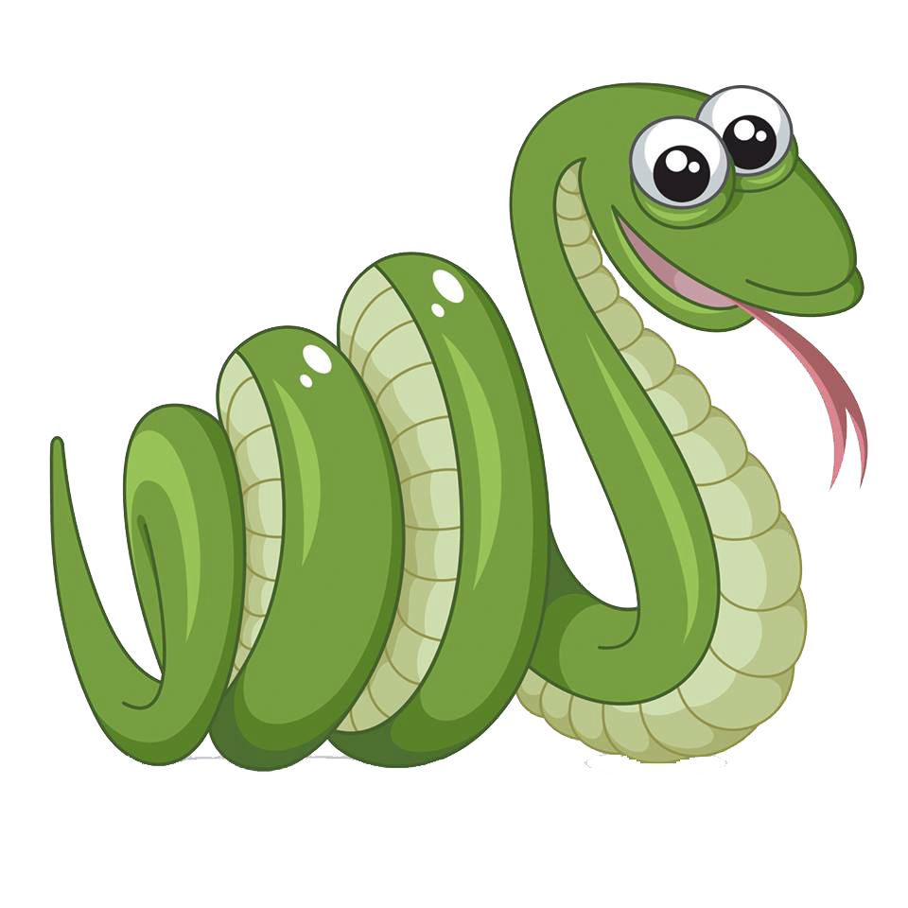
MY “GIUN”
Links: https://github.com/nguyenminhthong0208/snakegame
NGUYỄN TRẦN HOÀNG NAM
NGUYỄN KIM KHA
NGUYỄN MINH THÔNG
BÙI TIẾN ĐẠT

Slide 2
INDEX
MISSION OF TEAM MEMBER
HISTORY OF GAME
IDEAL DESIGN
CODE GAME AND EXPLAIN
PLAY GAME

Slide 3
MISSION OF MEMBER:
SNAKE GAME
NGUYỄN TRẦN HOÀNG NAM
NGUYỄN MINH THÔNG
Create the board and food
Control snake
BÙI TIẾN ĐẠT
NGUYỄN KIM KHA
Cases can happen in game
Combine all functions in the main function

Slide 4
IDEAL DESIGN
SNAKE GAME
STEP 1
STEP 2
STEP 3
CREATE BOARD
CREATE FOOD
CREATE SNAKE
- TOTAL ALL VALUE FROM INPUT
- PRINT IT IN SCREEN
- CLEAR SCREEN
- GET VALUE FROM INPUT AND RETURN STEP TWO

Slide 5
CREATE BOARD, FOOD AND SNAKE

Slide 6



NGUYỄN TRẦN HOÀNG NAM
Create the board and food
CREATE BOARD
CREATE SNAKE
CREATE FOOD

Slide 7
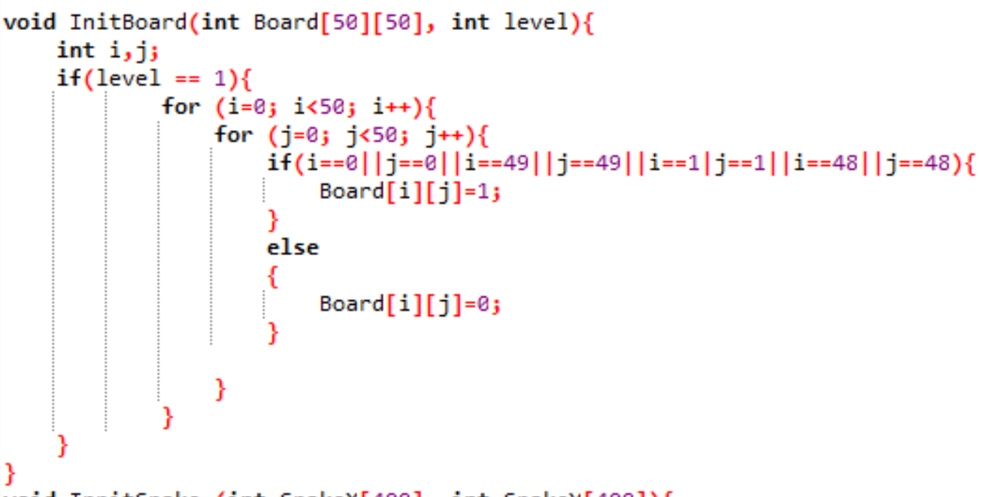
NGUYỄN TRẦN HOÀNG NAM
Create the board and food

Slide 8
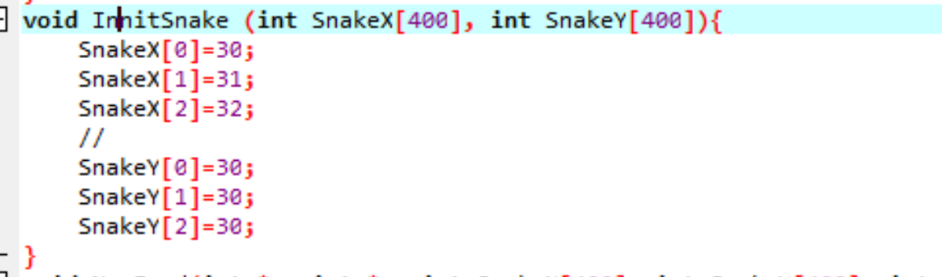
NGUYỄN TRẦN HOÀNG NAM
Create the board and food

Slide 9
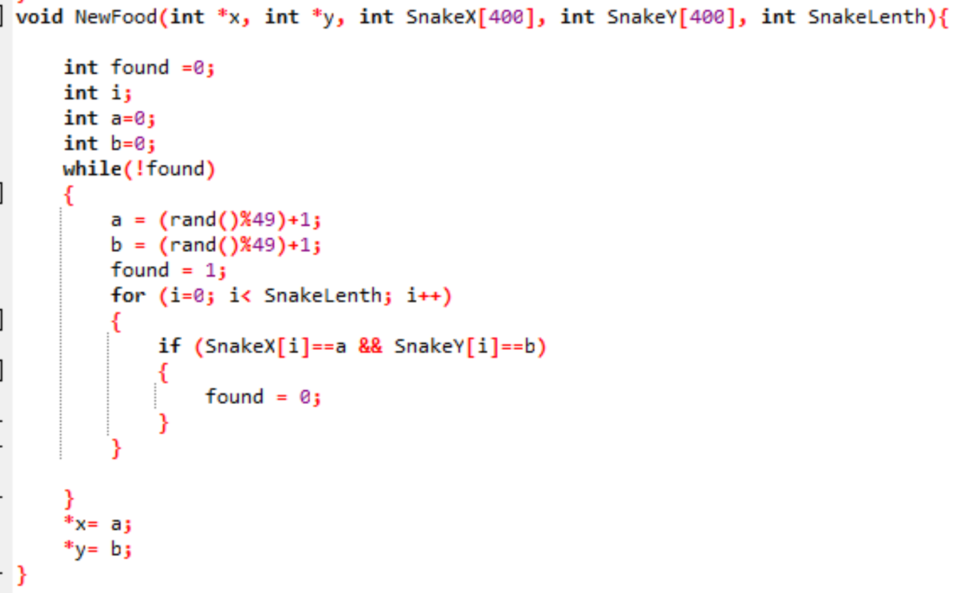
NGUYỄN TRẦN HOÀNG NAM
Create the board and food

Slide 10
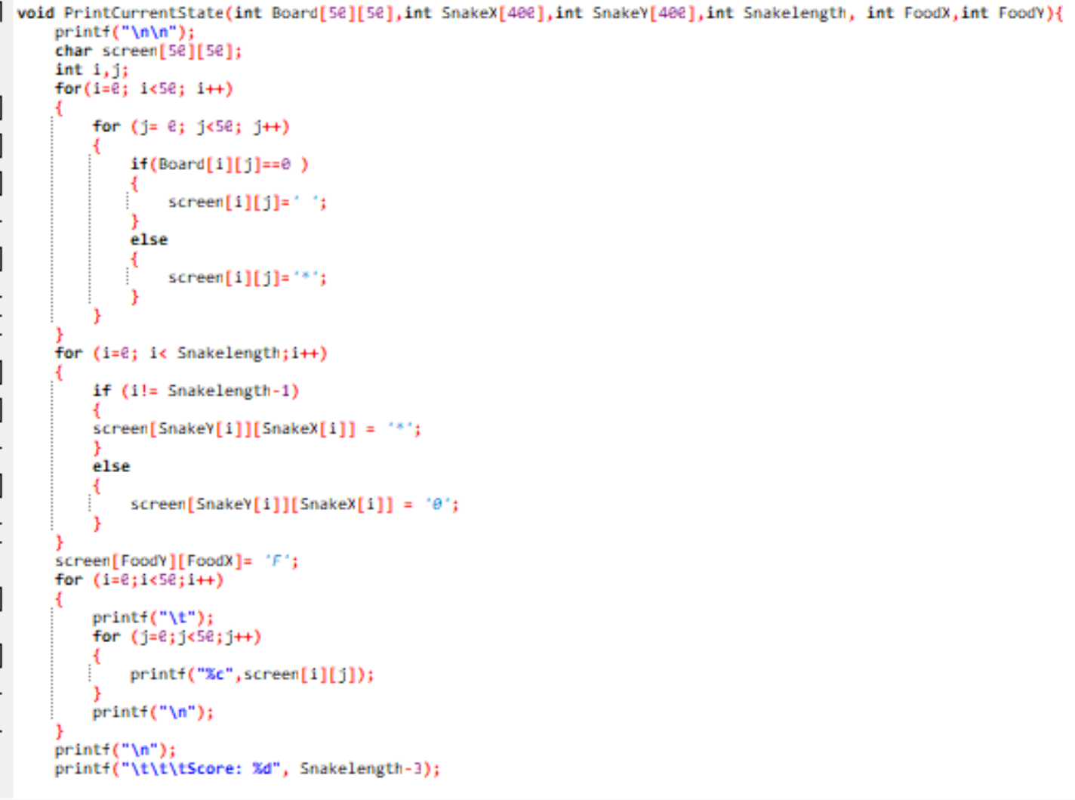
NGUYỄN TRẦN HOÀNG NAM
Create the board and food

Slide 11
CONTROL SNAKE

Slide 12
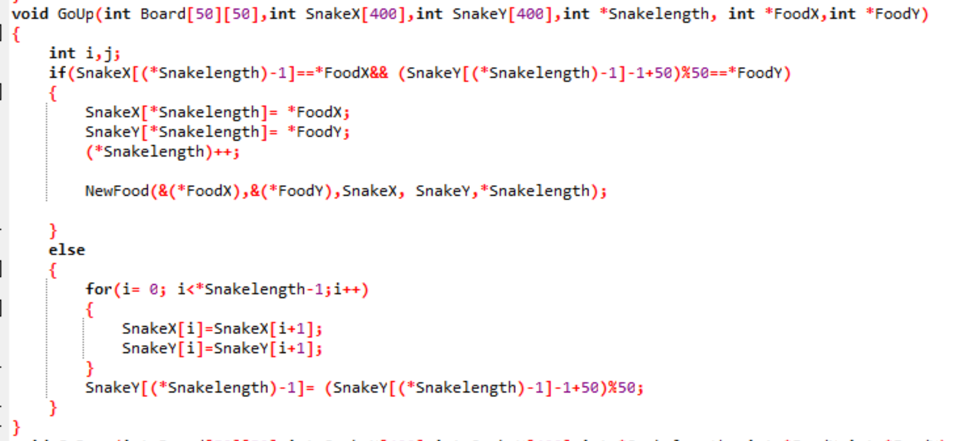
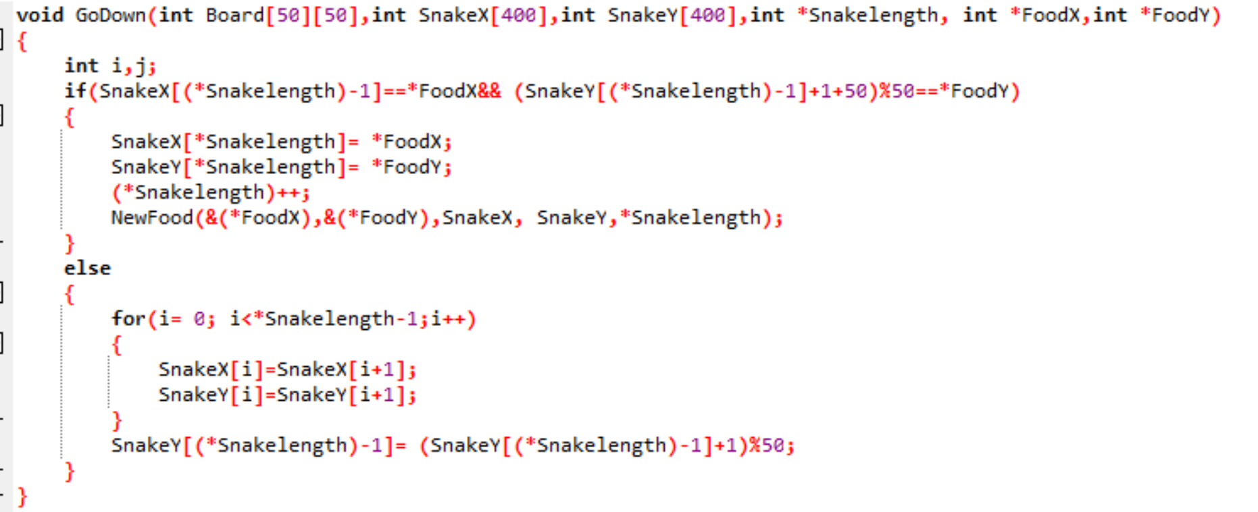
NGUYỄN MINH THÔNG
Control snake
GO UP
GO DOWN

Slide 13
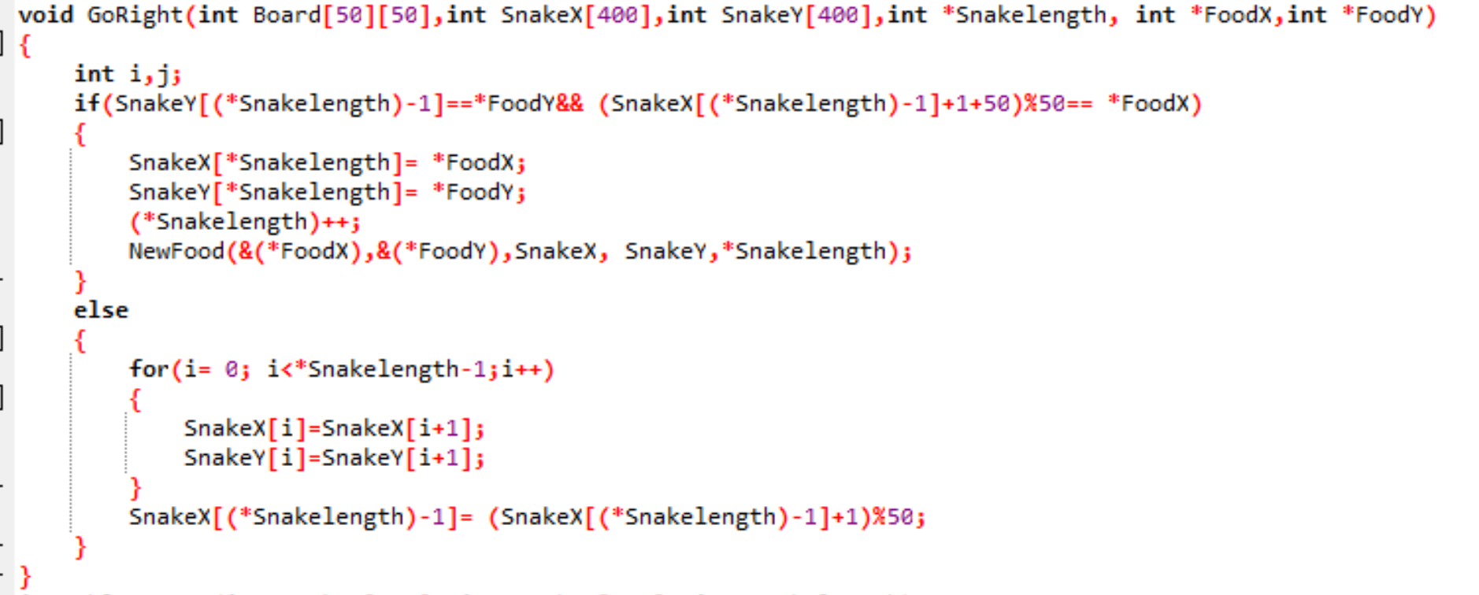
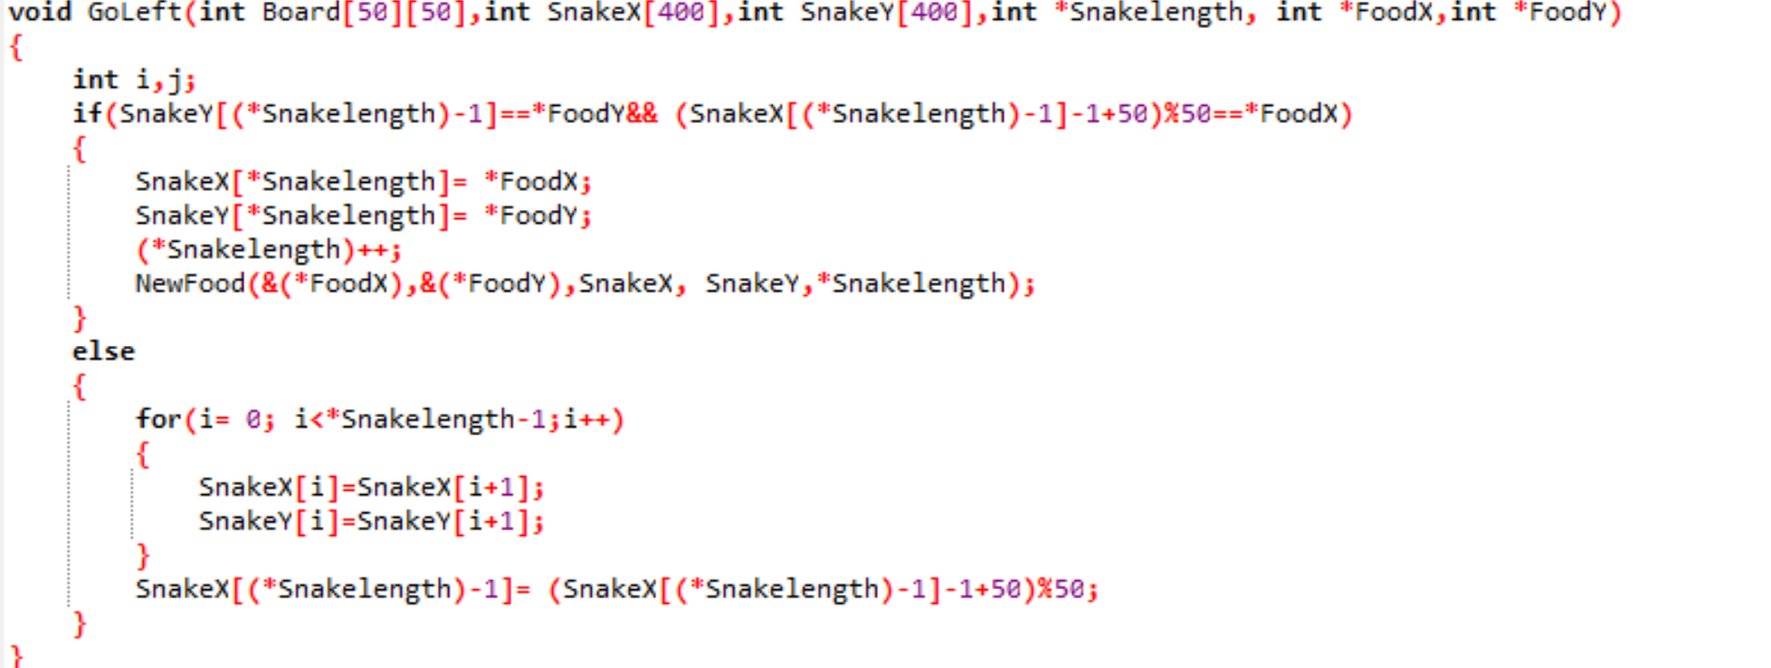
NGUYỄN MINH THÔNG
Control snake
GO RIGHT
GO LEFT

Slide 14
CASES CAN HAPPEN
IN GAME

Slide 15
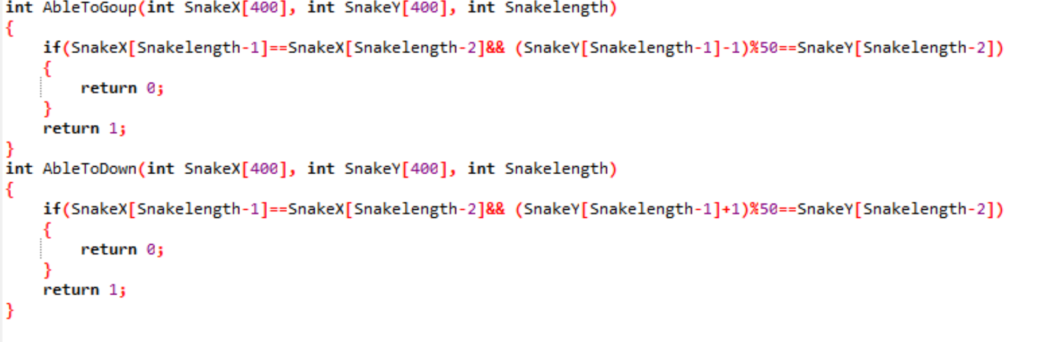
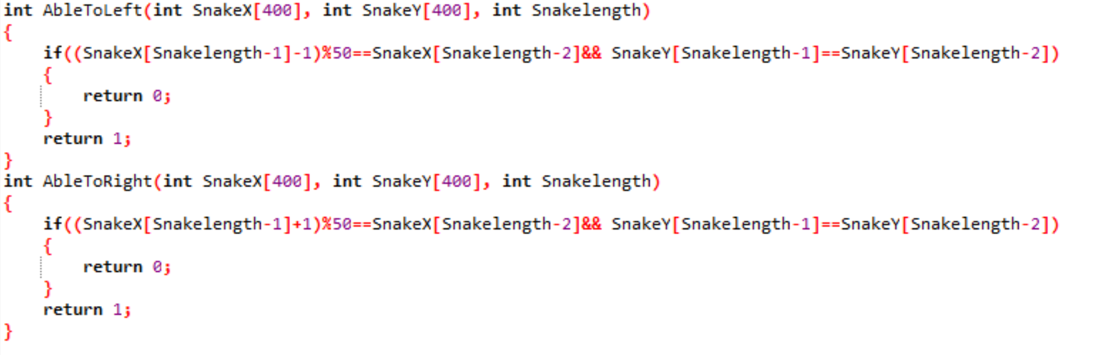
BÙI TIẾN ĐẠT
Case can happen in game

Slide 16
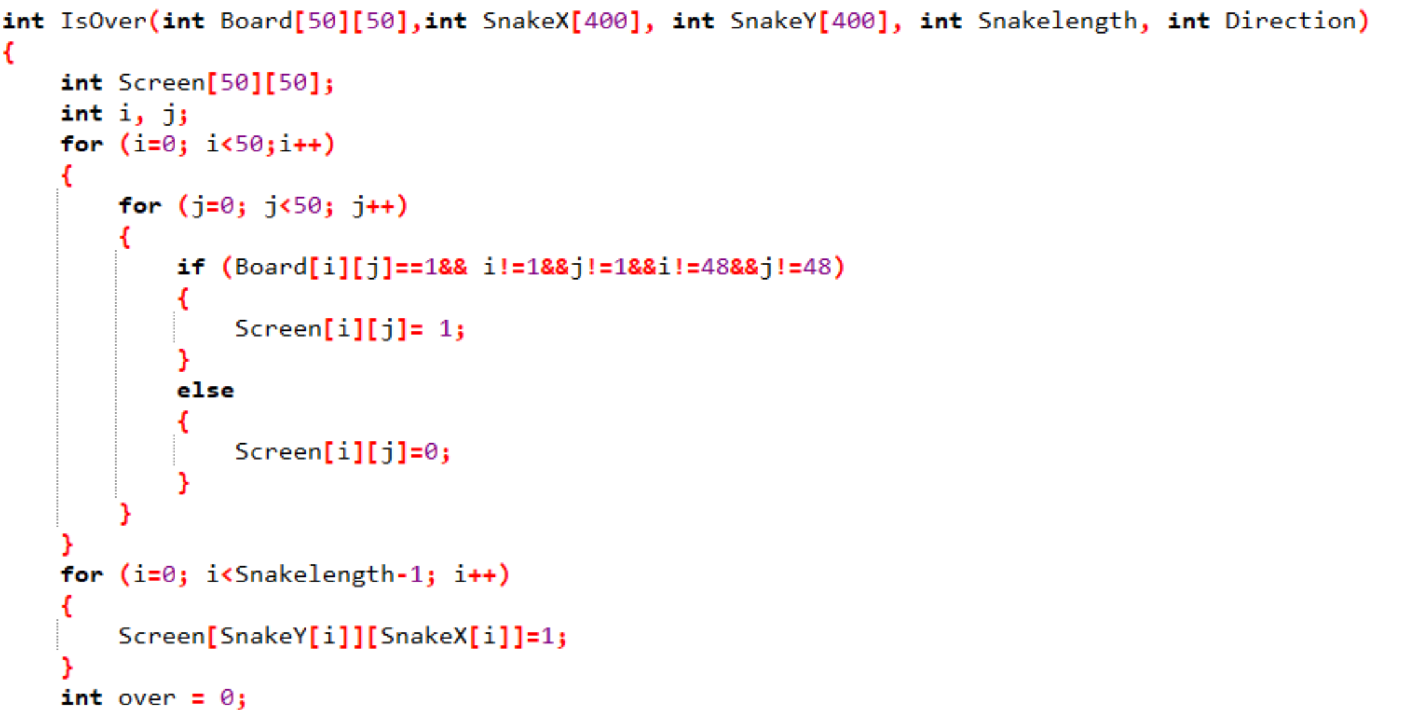
BÙI TIẾN ĐẠT
Case can happen in game

Slide 17
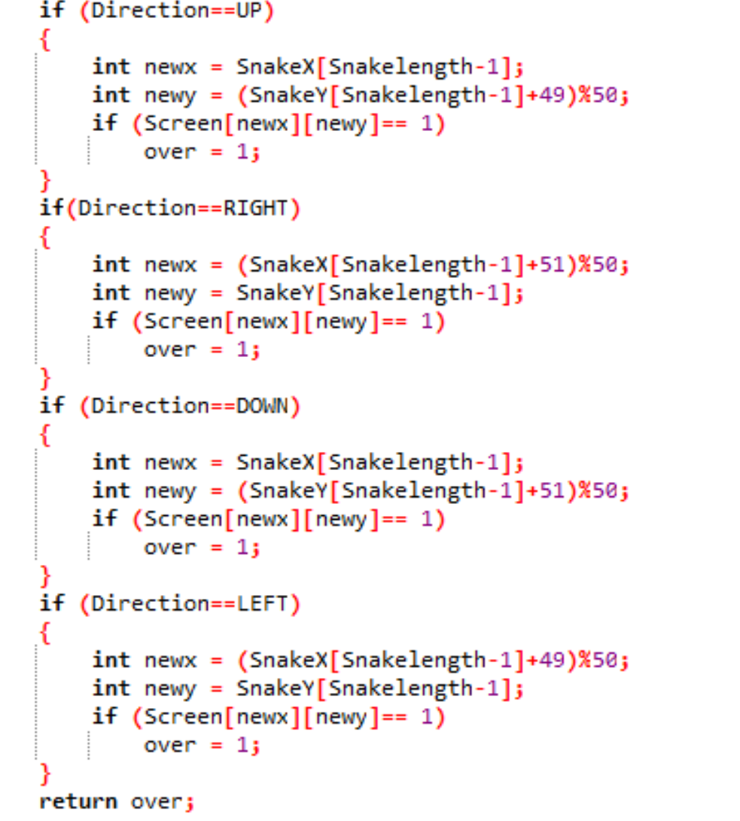
BÙI TIẾN ĐẠT
Case can happen in game

Slide 18
MAIN FUNCTION

Slide 19
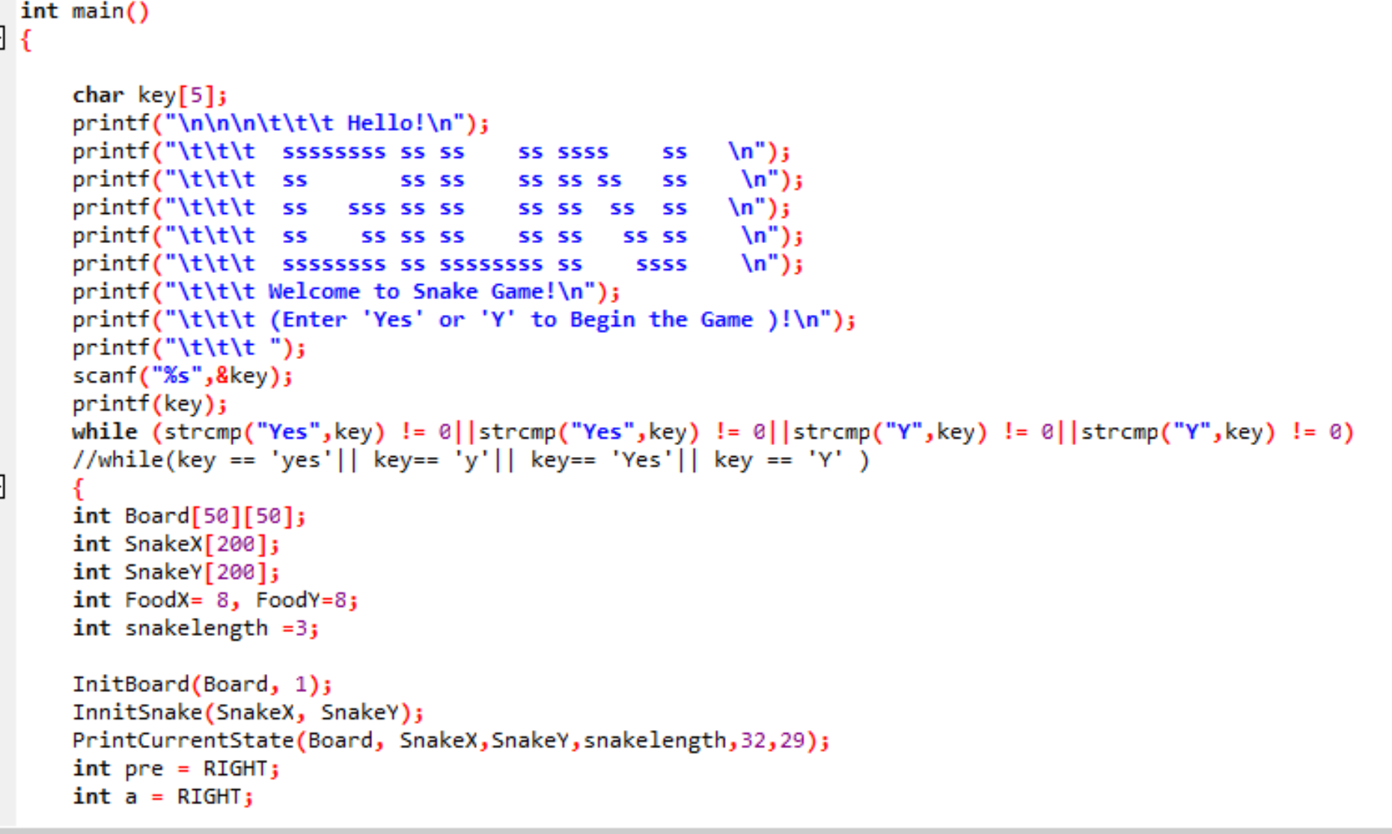
NGUYỄN KIM KHA
Main Function

Slide 20
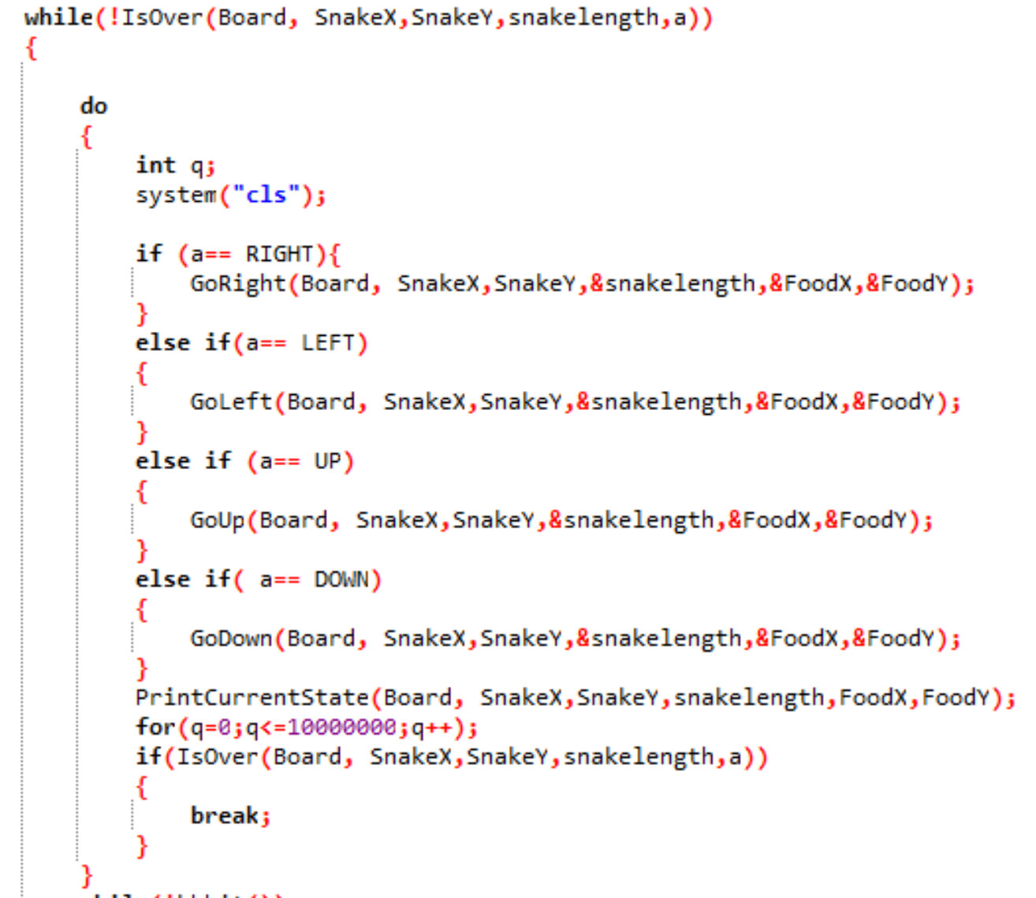
NGUYỄN KIM KHA
Main Function

Slide 21
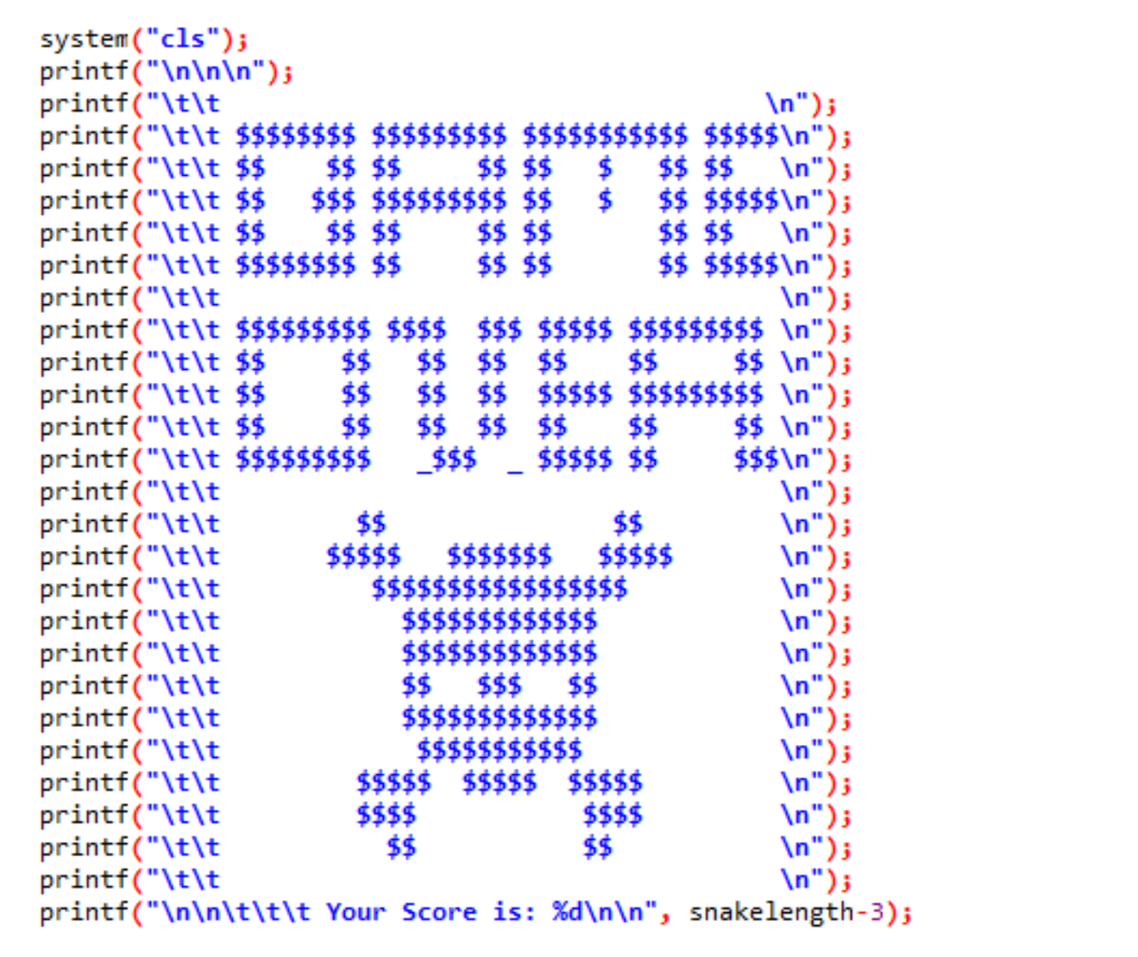
NGUYỄN KIM KHA
Main Function

Slide 22
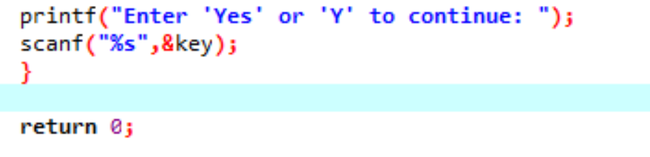
NGUYỄN KIM KHA
Main Function

Slide 23
Thanks for your watching
Any question?

Slide 24
LET’S PLAY GAME !

